Slide 1
Digital Logic Design
Assistant Lecturer
Saja Almofhafar

Slide 2
Today’s Lecture
Binary Arithmetic
Addition
Subtraction
Multiplication
Division

Slide 3
Addition
The addition table for binary numbers is
Carrying 1 to a column is equivalent to adding 1 to that column

Slide 4
Example

Slide 5
Subtraction
The subtraction table for binary numbers is:
Borrowing 1 from a column is equivalent to subtracting 1 from that column.

Slide 6
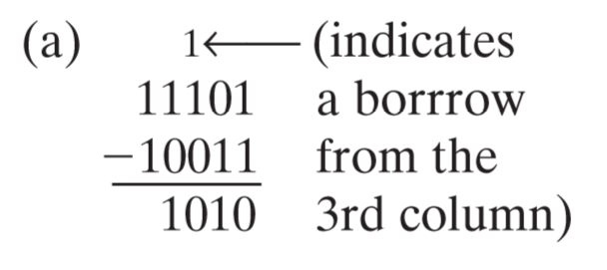
Example 1

Slide 7
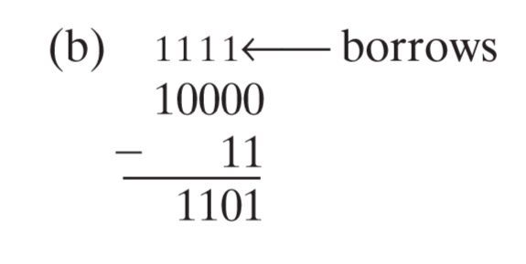
Example 2

Slide 8
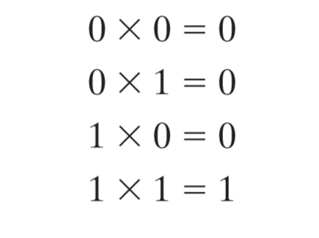
Multiplication
The multiplication table for binary numbers is:

Slide 9
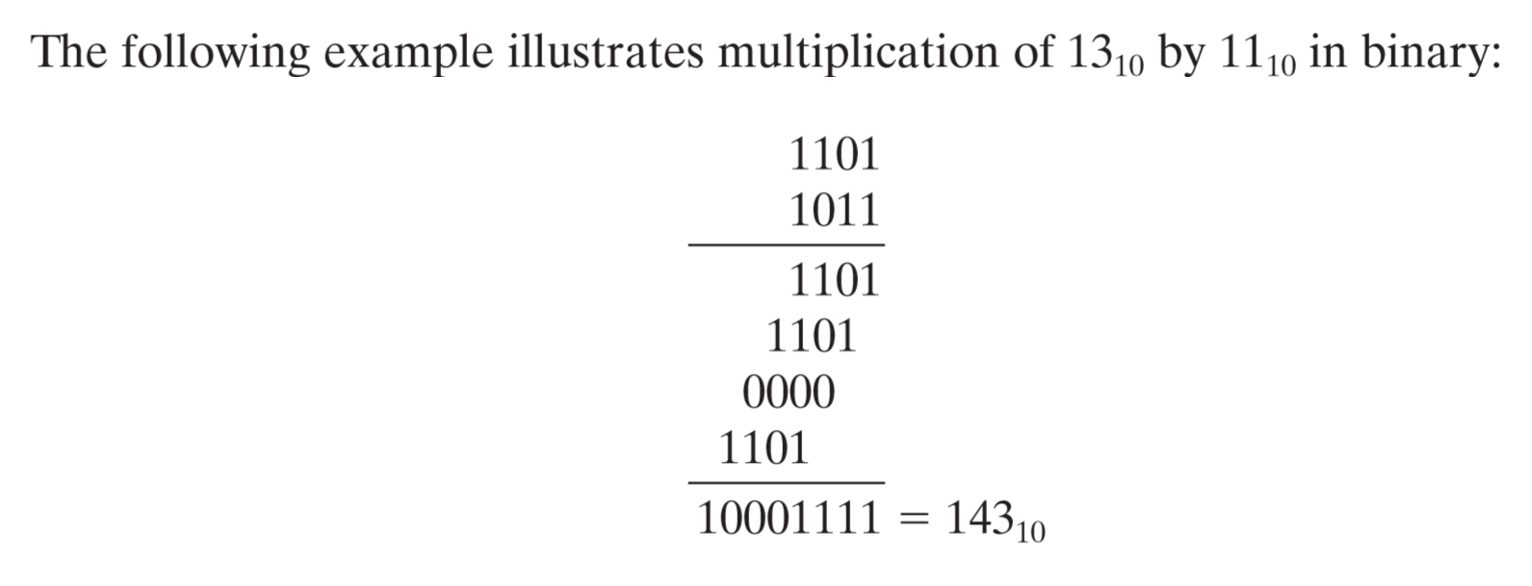

Slide 10
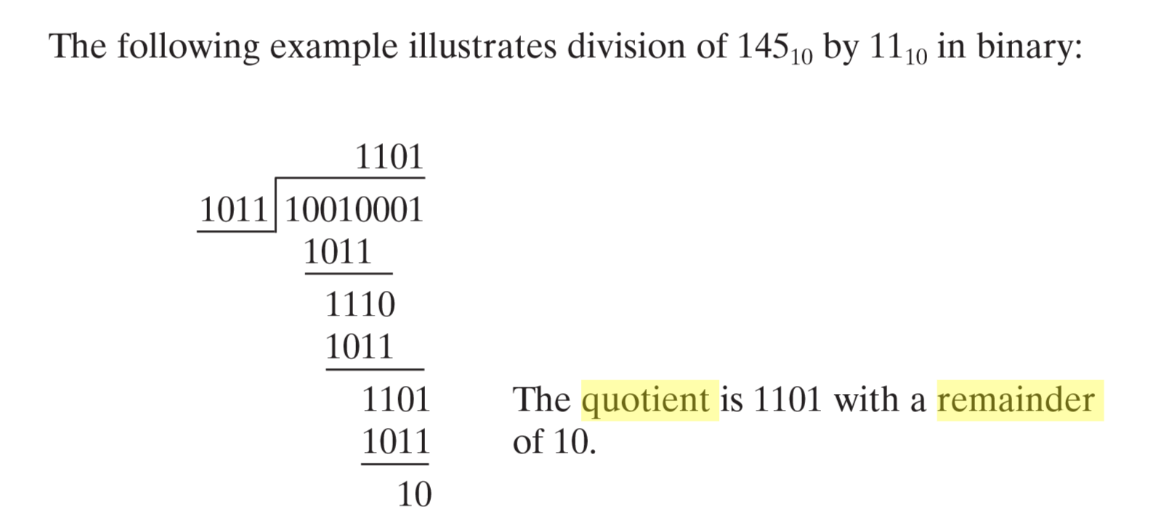
Division

